Slide 1
Plant species identification using computer vision
Data Science capstone, Fall 2018
Jack Crum

Slide 2
Introduction
Endangered Species Act of 1973: Section 2(a)(2)
“The policy of Congress that all Federal departments and agencies shall seek to conserve endangered species and threatened species and shall utilize their authorities in furtherance of the purposes of this Act.”
Expenditures on endangered species conservation plans total more than $800 million annually and include 218 plant species
Department of Defense (DoD) has the highest density of endangered species of any other federal agency, with 340 out of 420 large military installations requiring active conservation management plans to protect 492 listed species (274 animals, 218 plants).

Slide 3
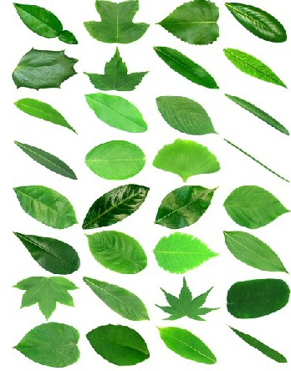
Problem statement
Large amounts of available images and data are ignored or overlooked due to lack of automation, manpower, and resources
Previously developed CNN models have good accuracy with leaves on white backgrounds (Flavia Dataset), not tested with natural background
The most popular current applications for planet identification still suffer from inabilities to deal with cluttered backgrounds and have single uploads
Project focus is to save conservation resources by developing a simple automated system for uploading large folders of images, identifying species in images, and sorting based on prediction

Slide 4
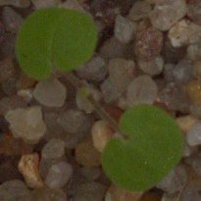
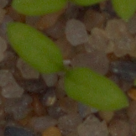
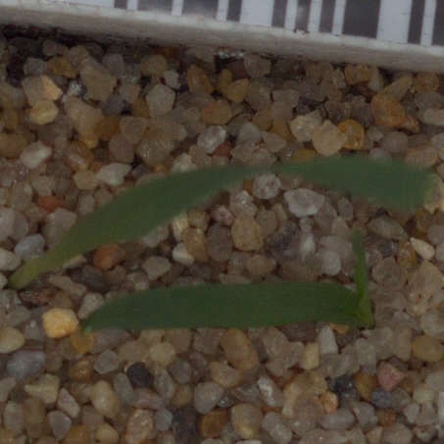
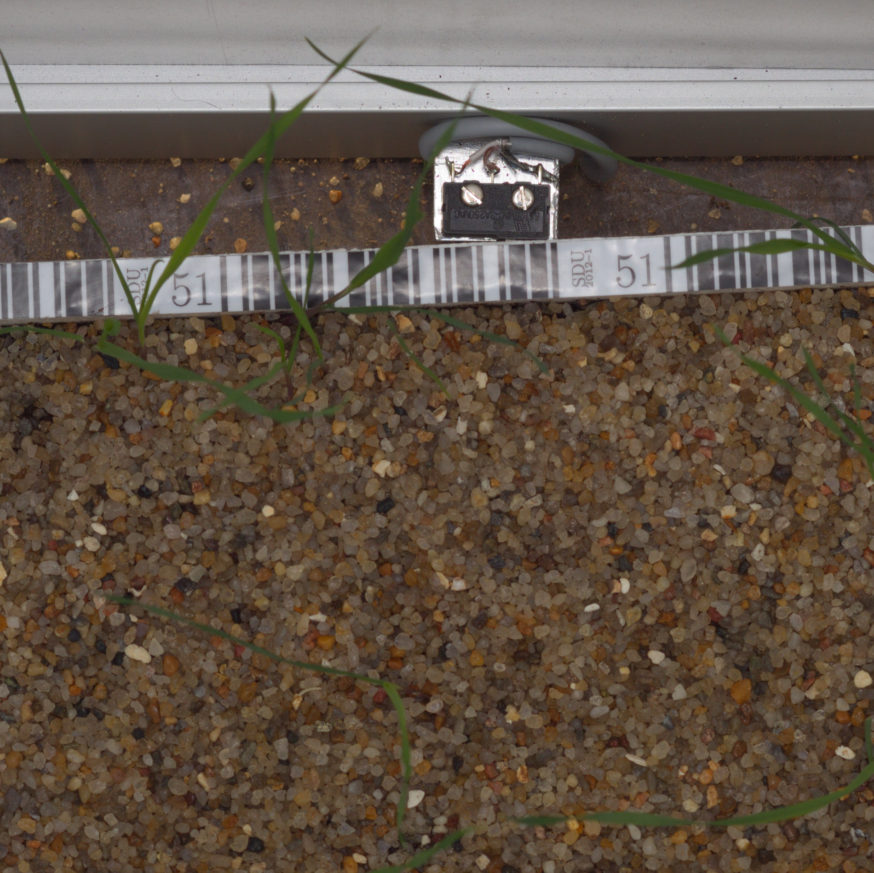
DataSet
Kaggle Plant Seedlings Classification Dataset
12 species in pre-split training/testing datasets
4750 training images
794 testing images
Testing set is not labelled
Uneven class distribution

Slide 5
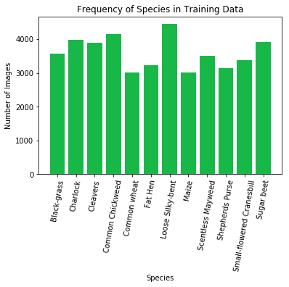
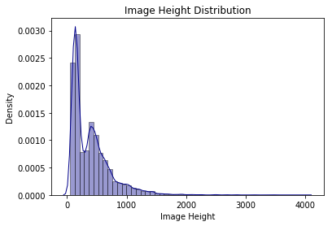
Data Augmentation
All Images were rotated 90˚, 180˚, and 270˚
Some were horizontally flipped and vertically flipped to create more uniform class distributions
50867 total images from original training set: 32429 training,10809 testing, 7629 validation

Slide 6
Image preprocessing: Normalization
Split into 3 RGB color channels
Subtracting the minimum pixel value from each pixel, dividing the result by the difference between the max and min, and multiply by 255
Maps minimum pixel value to 0 and maximum to 255 so the image spans the whole color spectrum
Increases contrast and negates effects of shadow and lighting

Slide 7
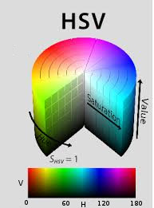
Image preprocessing: Masking
Change colorspaces from BGR (Blue, Green, Red) to HSV (Hue, Saturation, Value)
In OpenCV, Hue range is [0,179], Saturation range is [0,255] and Value range is [0,255].
Threshold the HSV image for a range of green color
Chosen range: (40, 0, 0) to (110, 255, 200)

Slide 8
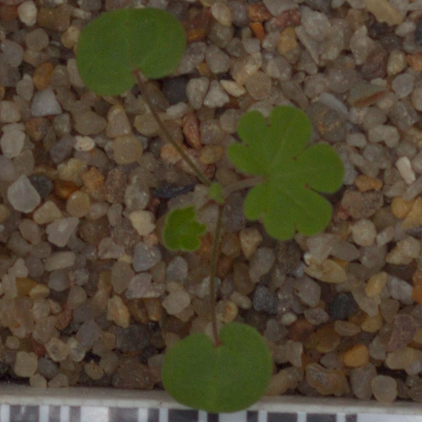
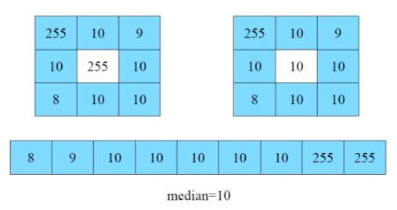
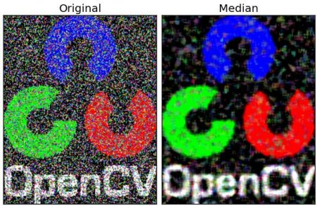
Image preprocessing: Median Blur
Computes median of all pixels under the kernel window and central pixel is replaced with this value
Highly effective in removing salt-and-pepper noise
9x9 kernel chosen for images

Slide 9
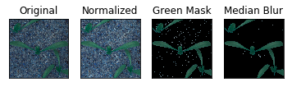
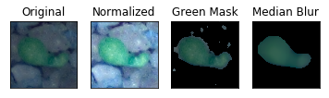
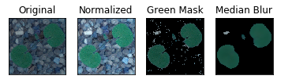
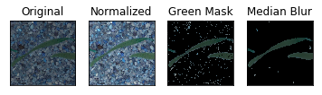
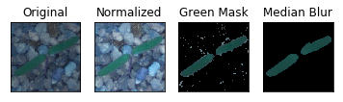
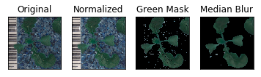
Image Preprocessing Results

Slide 10


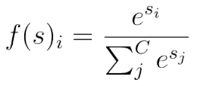
Neural Networks
Convolutional Neural Network
Convolutional Layers
Stride over image with various number of weight matrices to detect edges and patterns
Parameters include: Kernel Size, Stride, Padding
Activation
ReLU (
Max Pooling Layers
Shrink images based on maximum
value in kernel
Flatten
Flatten into 1d array
Fully Connected Layer
Fully connected layer
Softmax Output
Class probability

Slide 11
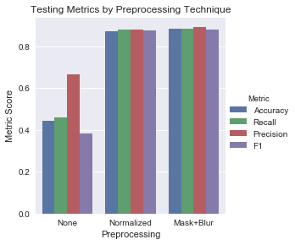
Preprocessing Techniques
Comparing:
No preprocessing
Min-max normalization
Min-max normalization + mask + median blur
Full preprocessing produced best results at:
88.2% accuracy
88.1% recall
89.2% precision
88% F1

Slide 12
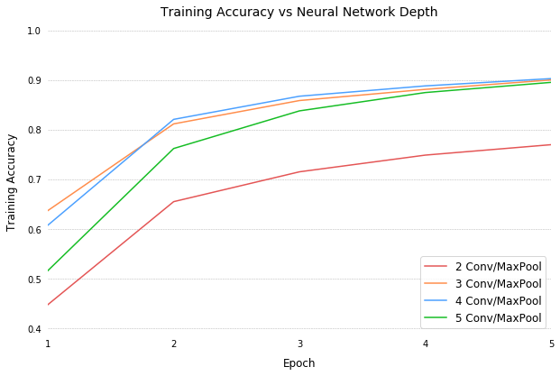
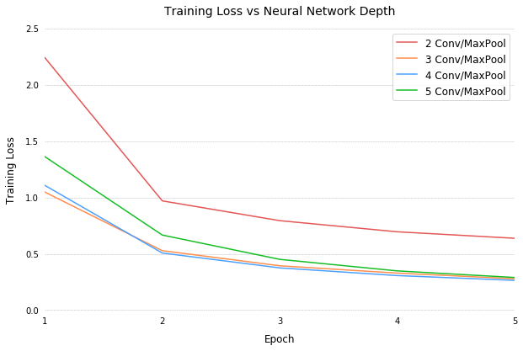
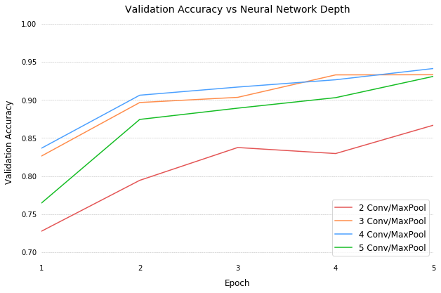
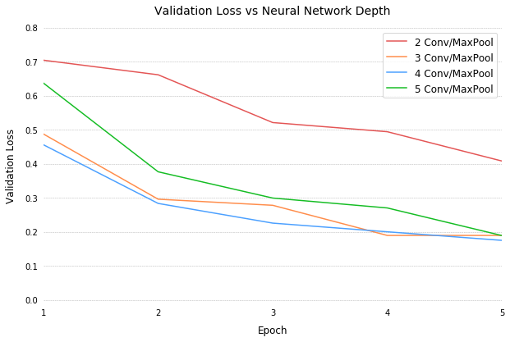
Network architecture: Layers
Conv Block:
1 Convolution Layer
32 Feature Maps
5x5, 3x3 Kernels
Batch Normalization
ReLU Activation
Max Pool (2x2)
Architecture:
Conv Blocks
Flatten Layer
FC1 Layer (128x1)
Dropout(0.1)
FC2 Layer (12x1)
Softmax Activation

Slide 13
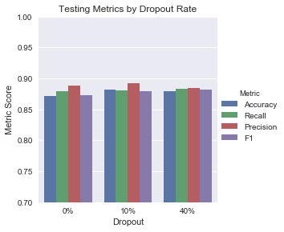
Network architecture: dropout
Dropout on first FC Layer at three rates:
0% Neuron dropout
10% Neuron dropout
40% Neuron dropout
10% Neuron dropout with highest accuracy (88.2%) and highest precision (89.2%)
Dropout | Accuracy | Recall | Precision | F1
0% | 0.8715 | 0.8795 | 0.889 | 0.873
10% | 0.882 | 0.881 | 0.892 | 0.88
40% | 0.8795 | 0.8839 | 0.885 | 0.8821

Slide 14
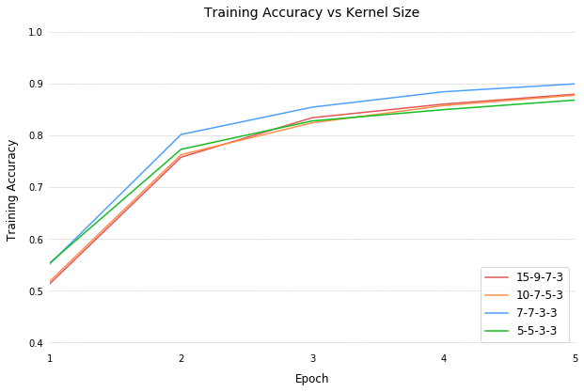
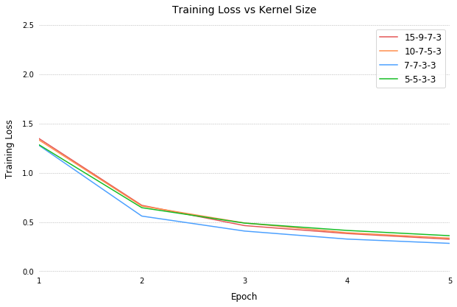
Network architecture: kernel size
Four architectures were tested:
15x15-9x9-7x7-3x3
10x10-7x7-5x5-3x3
7x7-7x7-3x3-3x3
5x5-5x5-3x3-3x3.
 |  | 15-9-7-3 | 10-7-5-3 | 7-7-3-3 | 5-5-3-3
Training | Accuracy | 0.8795 | 0.8776 | 0.871 | 0.8898
 | Loss | 0.325 | 0.3365 | 0.3542 | 0.3049
Validation | Accuracy | 0.9194 | 0.8651 | 0.9014 | 0.9248
 | Loss | 0.2221 | 0.335 | 0.2708 | 0.203
 | Parameters | 313,708 | 244,364 | 205,854 | 196,204
 | Train Time | 2452 | 1540 | 1296 | 1305

Slide 15
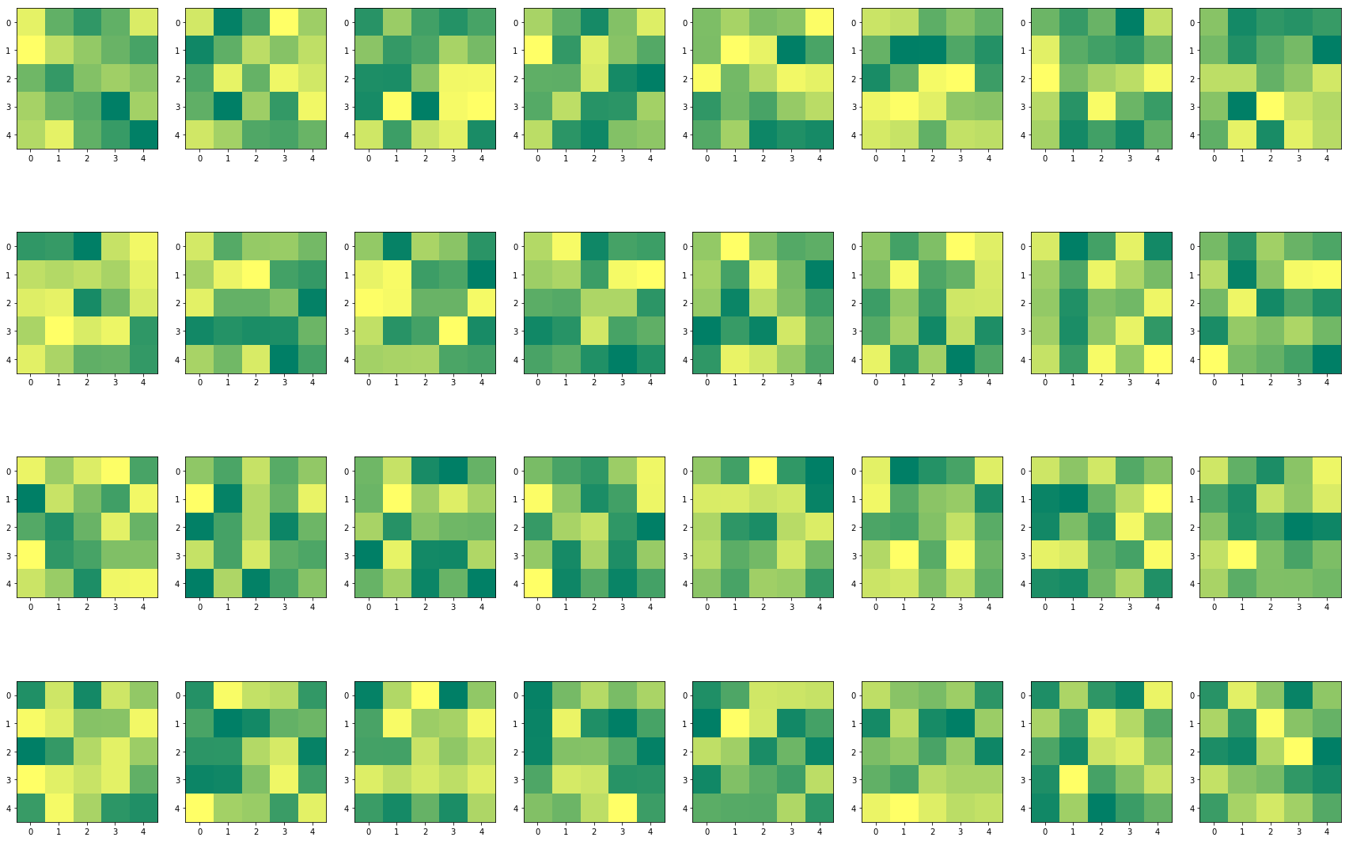
5x5 Kernels of first convolution layer

Slide 16
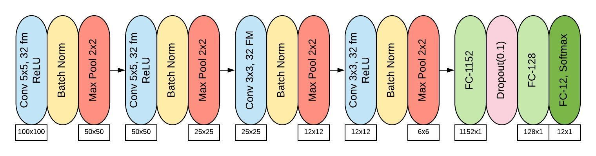
Final model
Preprocessing: Min-Max Normalization + Green Mask + Median Blur

Slide 17
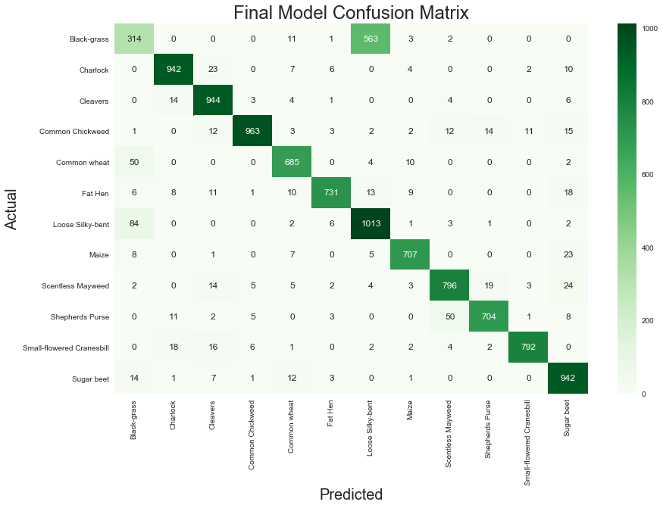
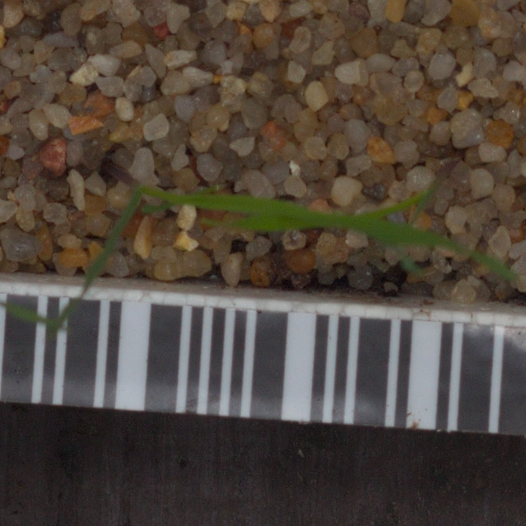
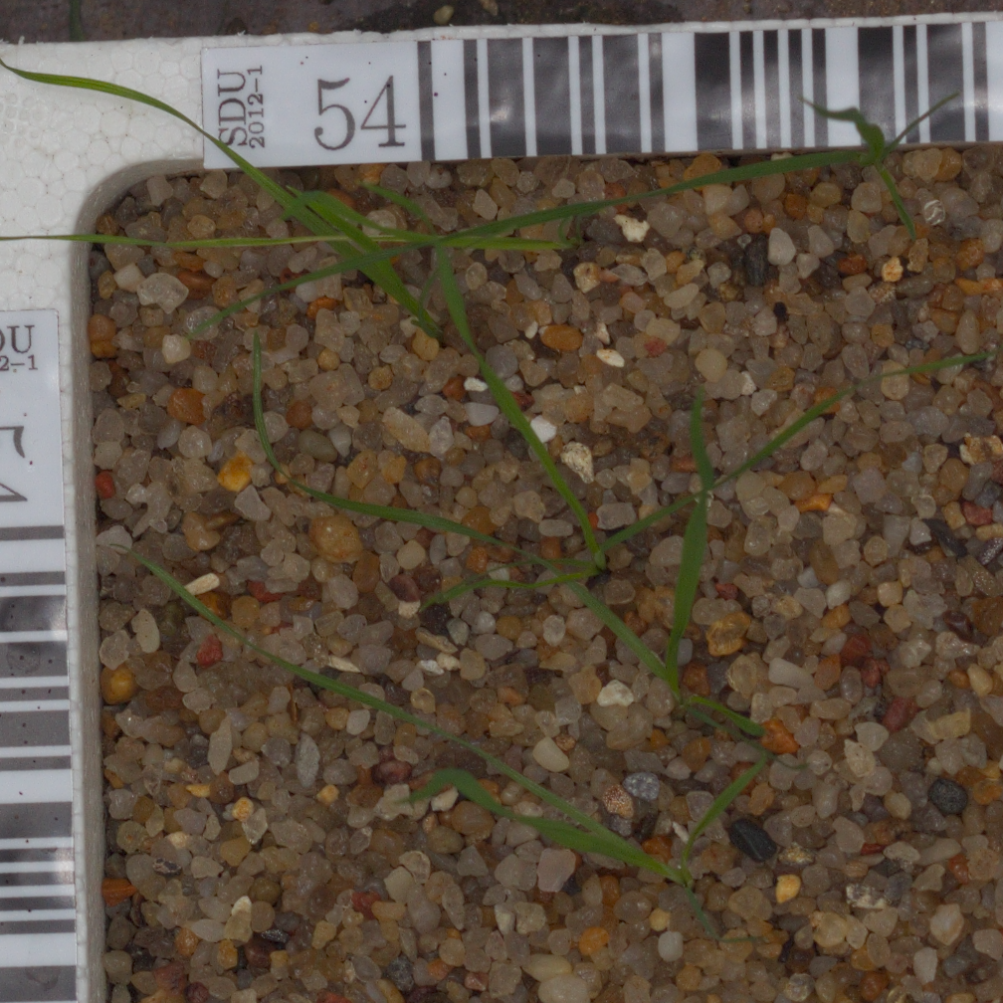
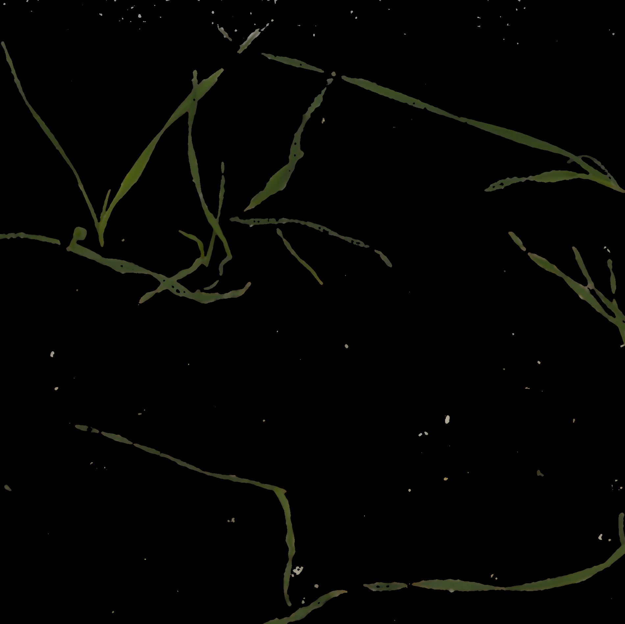
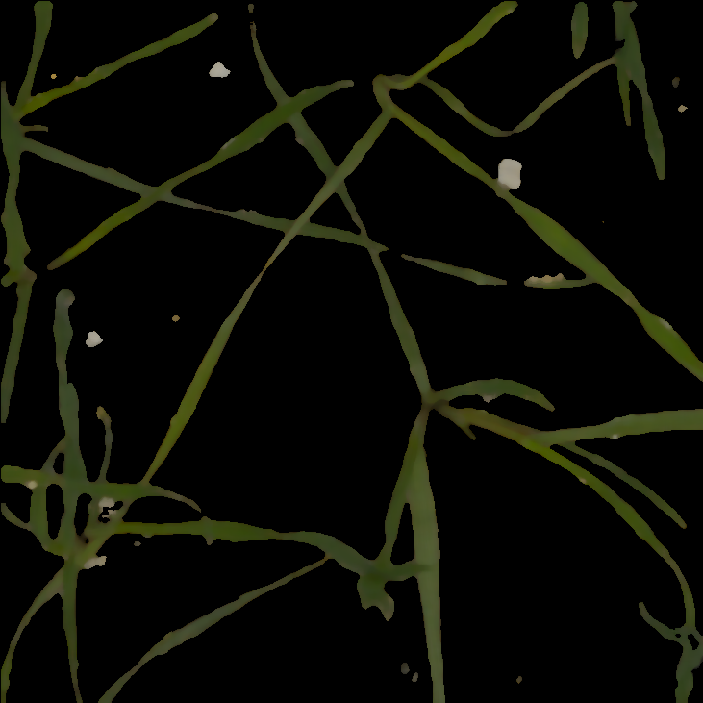
Accuracy: 0.8820
Recall: 0.8802
Precision: 0.8923
F1: 0.8808
Black-grass
Loose Silky-bent

Slide 18

Flask Application
Python micro web framework to develop web applications
Connect frontend HTML and JavaScript with backend Python using templates and connect pages using route decorators
Upload files through upload bar, run each image in file through model, output graphics, and sort on local file system

Slide 19
Questions?

